Slide 1
Laboratory work 1
Algae

Slide 2
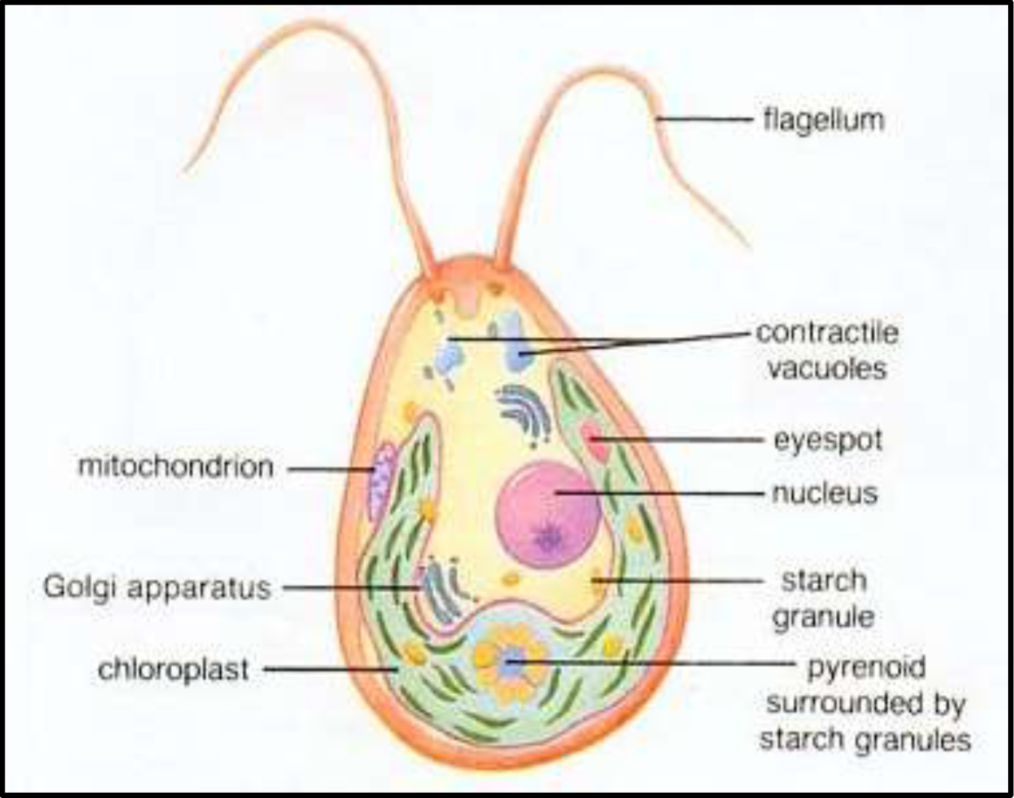
MORPHOLOGY OF AN ALGAL CELL

Slide 3
Blue-green Algae (Division Cyanophyta)
The division Cyanophyta or Myxophyta, commonly known as blue-green algae, consists of a single class Cyanophyceae.
The reference to “algae” in the name of these organisms indicates that the designation is used loosely for they are often considered to be more closely related to bacteria than to true algae.
The cell walls of blue-green algae differ from those of most bacteria in that they usually contain cellulose, but like those of bacteria, they also usually seem to contain muramic acid. Outside the cell wall proper, there is often a layer of a more or less firm, gelatinous material called a sheath, composed of pectic materials.
All blue-green algae possess photosynthetic pigments located in lamellar structures that appear to be flattened vesicles. These structures are similar to the chromatophores of the photosynthetic bacteria. Like the chromatophores, they are not contained within chloroplasts. The cells contain a number of pigments including chlorophyll, carotene, phycocyanin, and phycoerythrin.
The Cyanophyta are characterized by the complete absence of sexual reproduction; no sexual organs and no motile reproductive bodies have been observed. Propagation takes place by simple division, by spores (akinetes, endospores, and exospores) or else by fragmentation (fission). The multiplication of unicelluar and colonial forms is brought about mainly by simple cell division.

Slide 4
Material:
Division Cyanophyta - Blue-green Algae
Class Chroococcophyceae,
Order Chroococcales,
Genus Gloeocapsa, Microcystis
Objective: To investigate the structural features of Gloeocapsa, Microcystis.
Tasks of work:
Draw a colony, label in the picture private, general envelope of Gloeocapsa;
Draw a part of the colony and individual cells with gas vacuoles of Microcystis.

Slide 5
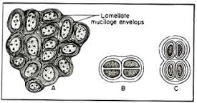
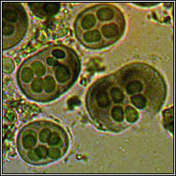
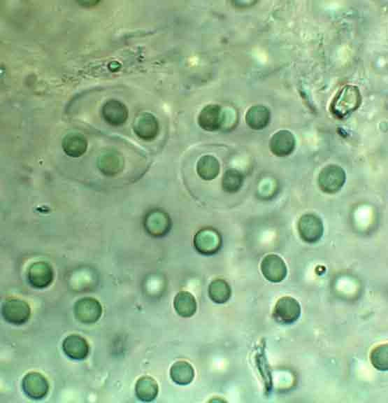
Gloeocapsa. A – Cells in group, B,C – Cells within envelop
The order is characterized by single, floating cells or colonies which are embedded to a matrix.
The cells secrete individual gelatinous sheaths which can often be seen as sheaths around recently divided cells within outer sheaths. Recently divided cell pairs often appear to be only one cell since the new cells cohere temporarily.
Gloeocapsa

Slide 6
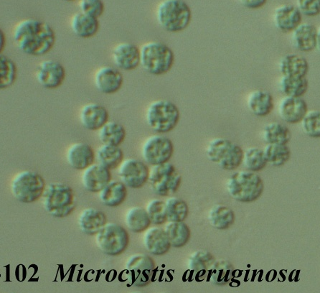
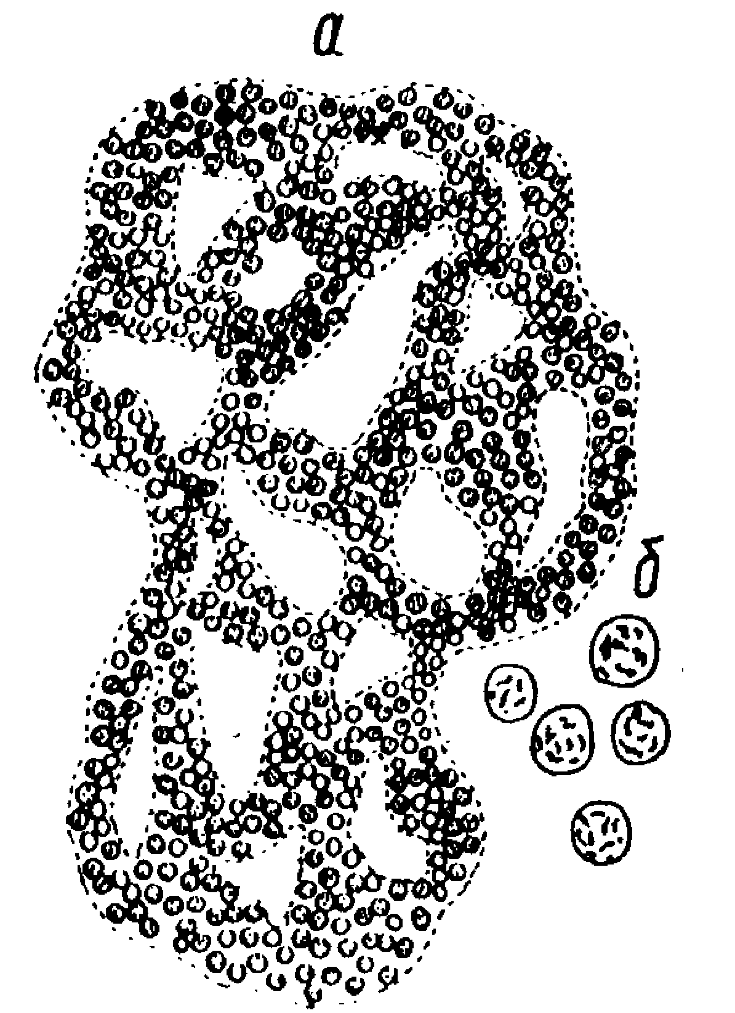
Microcystis
Microcystis is characterized by small cells (a few micrometers in diameter), possessing gas filled vesicles (also lacking individual sheaths). The cells are usually organized into colonies (macroscopic aggregations of which are visible with the naked eye).
a - general view of the colony;
b - single cells

Slide 7
Material:
Division Cyanophyta - Blue-green Algae
Class Hormogoniophyceae
Order Oscillatoriales,
Genus Oscillatoria, Spirulina
Objective: To investigate the structural features of Oscillatoria, Spirulina,
Tasks of work:
Draw appearance Oscillatoria, Spirulina

Slide 8
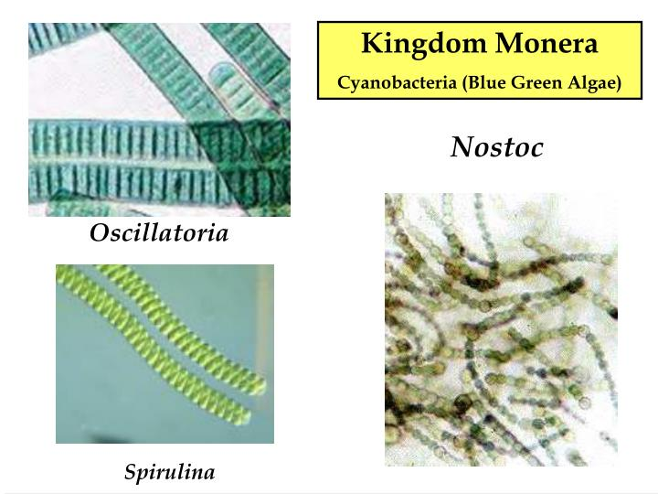
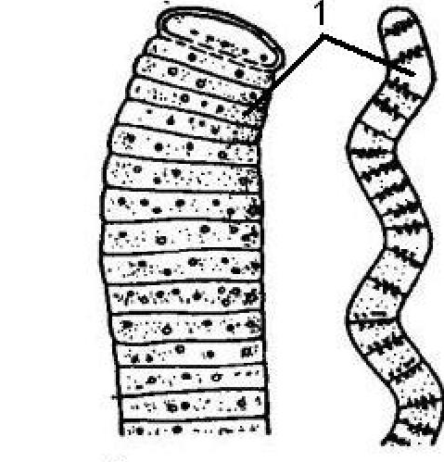
Oscillatoria
cells
Spirulina
Oscillatoria Spirulina
general view

Slide 9
Material:
Division Cyanophyta - Blue-green Algae
Class Hormogoniophyceae,
Order Nostocales,
Genus Nostoc, Anabaena
Objective: To investigate the structural features of Nostoc, Anabaena
Tasks of work:
Draw the appearance of the colony of Nostoc and the incision of the colony under a microscope. Denote vegetative cells and heterocysts.
Draw appearance Anabaena. Denote vegetative cells, akinete and heterocysts.

Slide 10
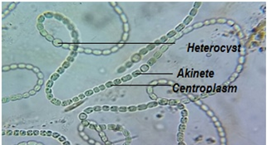
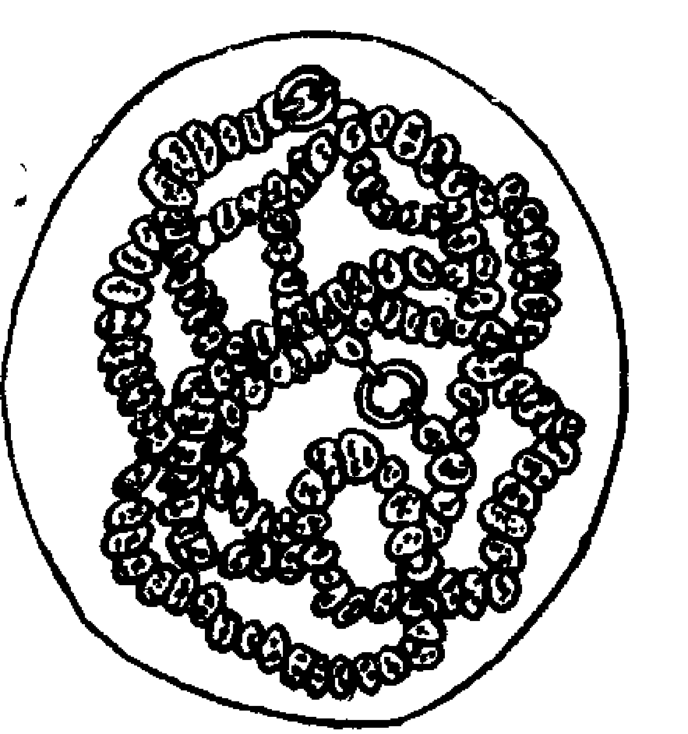
Nostoc
Nostoc is a genus of cyanobacteria found in various environments (are common in both aquatic and terrestrial areas) that forms colonies composed of filaments of moniliform cells in a gelatinous sheath. It is usually formed of ball-like gelatinous colonies composed of filaments called trichomes.
Along the filament some large, spherical or cylindrical, colourless
empty cells called heterocyst are found. It helps in fixing nitrogen during nitrogen starvation of cyanobacteria.
Moreover, an essential survival structure called akinetes is present in Nostoc. It also has photosynthetic pigment in their cytoplasm; hence they can also perform photosynthesis
Nostoc

Slide 11
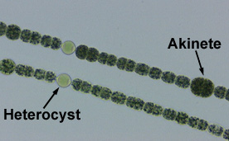
Anabaena
Anabaena, genus of nitrogen-fixing blue-green algae with beadlike or barrel-like cells and interspersed enlarged spores (heterocysts), found as plankton in shallow water and on moist soil. There are both solitary and colonial forms, the latter resembling a closely related genus, Nostoc. In temperate latitudes during the summer months, Anabaena may form water blooms.
Anabaena

Slide 12
The Green algae - Division Chlorophyta
> Chlorophyta is the division of the green algae.
> They are principally freshwater species.
> They are also found in sea water, and many other terrestial ecosystems.
> This division contain around 500 genera and around 8000 species.
> There are many single celled forms and many colonial types of green algae.
> Many unicellular green algae are motile by flagella action.
> Colonial types occur as spheres, filaments or plates.

Slide 13
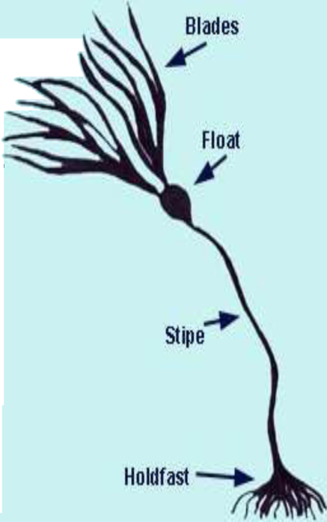
> Some species have special structures called holdfasts, which anchor them to submerged objects or aquatic plants.
> The cells of the chlorophycophyta have a well-
defined nucleus and usually a cell wall and the
chlorophyll and other pigments are in chloroplasts as in higher plants.
> Majority of the green algae contain one chloroplasts per cell.
> The cholorplasts contains chlorophyll a and b.
> Green algae reproduce both sexually and asexually.
> The cholorplasts are green because they are not masked by any accessory pigments. Because of this character, the members of chlorophyta are called as green algae.
> The chlorophyta has a characteristic set of acessory pigments such as в-carotene and Xanthophylls.
Asexual reproduction is by zoospores. They are flagellates produced from the parent cells by mitosis.Also by aplanospores, hepnospores, akinetes, palmella stage etc.

Slide 14
Material:
Division Chlorophyta - Green algae,
Class Volvocophyceae
Order Volvocales,
Genus Chlamydomonas, Pandorina,
Objective: To investigate the structural features of Chlamydomonas, Pandorina
Tasks of work:
Draw and denote the sheaths, chloroplast, eye-stigma, contractile vacuoles, flagella of Chlamydomonas;
Draw a the colony, flagella, individual cells of Pandorina.

Slide 15
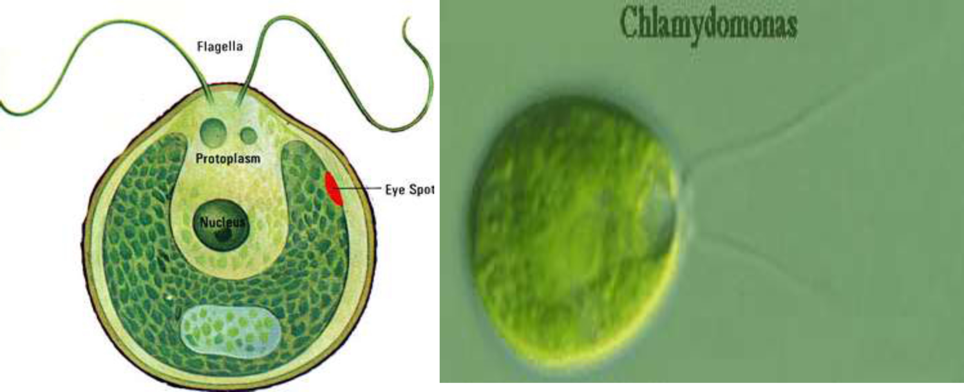
Chlamydomonas:
> It is a typical unicellular motile green algae widely distributed in stagnant water, damp soils and even in snow as “Snow algae”. (Chlamydomonas nivalis - found in snow).
> They reproduce both sexually and asexually.
> Model organism

Slide 16
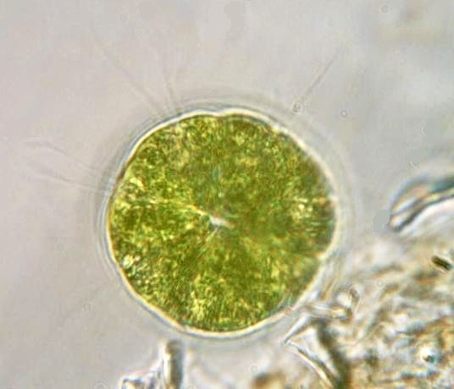
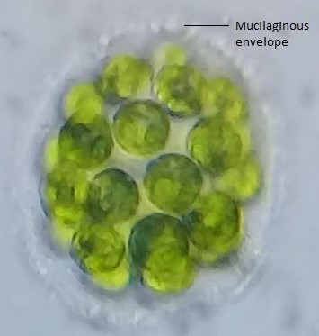
Pandorina is a genus of green algae composed of 8, 16, or sometimes 32 cells, held together at their bases to form a sack globular colony surrounded by mucilage. The cells are ovoid or slightly narrowed at one end to appear keystone- or pear-shaped. Each cell has two flagella with two contractile vacuoles at their base, an eyespot, and a large cup-shaped chloroplast with at least one pyrenoid.
Pandorina

Slide 17
Material:
Division Chlorophyta - Green algae,
Class Protococcophyceae,
Order Chlorococcales
Genus Hydrodictyon,
Objective: To investigate the structural features of Hydrodictyon
Tasks of work:
Draw appearance of the colony Hydrodictyon,

Slide 18
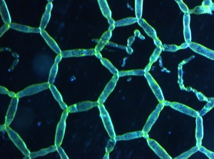
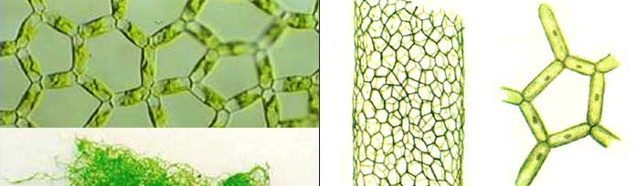
Hydrodictyon
The water net (genus Hydrodictyon) is a taxon of green algae of the family Hydrodictyaceae. The name water net comes from the (usually pentagonal or hexagonal) mesh structure of their colonies, which can extend several decimeters.
Hydrodictyon

Slide 19
Material:
Division Chlorophyta - Green algae,
Class Volvocophyceae,
Order Volvocales,
Genus Volvox
Objective: To investigate the structural features of Volvox.
Tasks of work:
Draw appearance of the colony Volvox, denote vegetative and generative cells.

Slide 20
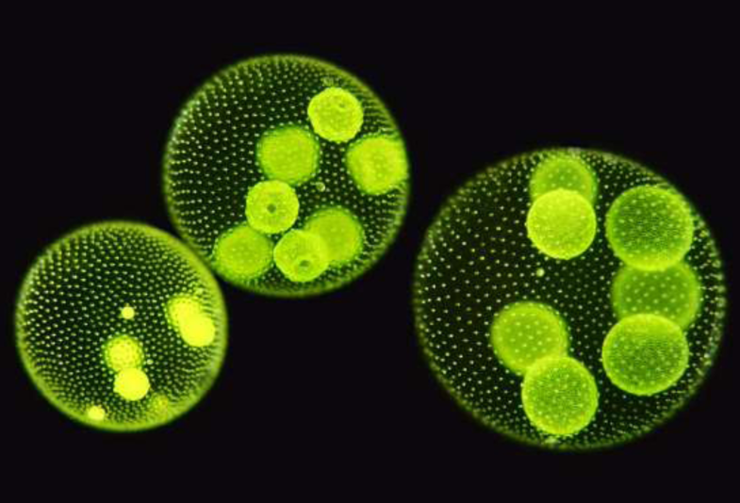
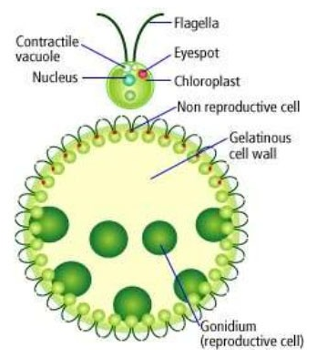
Volvox:
> Volvox is a colonial green algae. Each mature Volvox colony is composed of up to thousands of cells from two differentiated cell types: numerous flagellate somatic cells and a smaller number of germ cells lacking in soma that are embedded in the surface of a hollow sphere or coenobium containing an extracellular matrix made of glycoproteins.
> Found in freshwater habitats.
> It forms spherical colonies of up to 50,000 cells.
> The individual cells are biflagellate and are morphologically similar to that of Chlamydomonas.

Slide 21
Material:
Division Chlorophyta - Green algae,
Class Conjugatophyceae,
Order Zygnematales,
Genus Spirogyra
Objective: To investigate the structural features of Spirogyra
Tasks of work:
Draw appearance of the thallus Spirogyra and conjugation

Slide 22
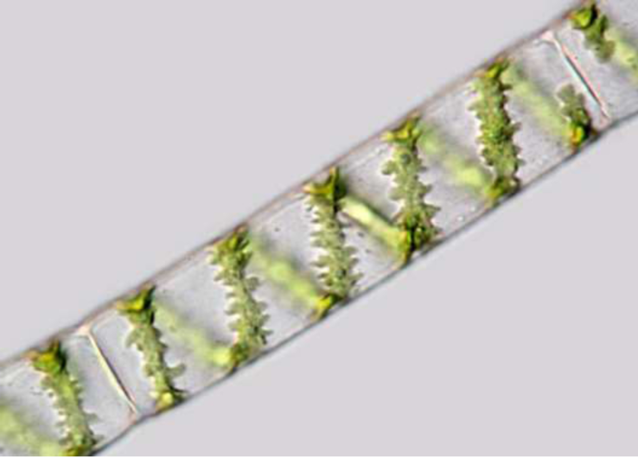
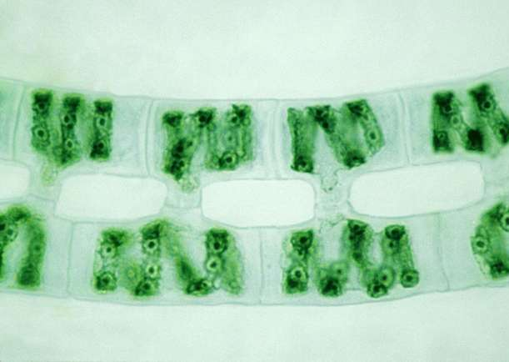
Spirogyra:
Spirogyra conjugation
> Also known as pond silk, water silk or blanket weed.
> It is a filamentous green algae.
> Named for the helical or spiral arrangement of the chloroplasts.
> Spirogyra is very common in relatively clean eutrophic water, developing slimy filamentous green masses.

Slide 23
Material:
Division Chlorophyta - Green algae,
Class Ulotrichophyceae
Order Ulvales,
Genus Ulva
Objective: To investigate the structural features of Ulva,
Tasks of work:
Draw the appearance of a thallus of Ulva and its life cycle.

Slide 24
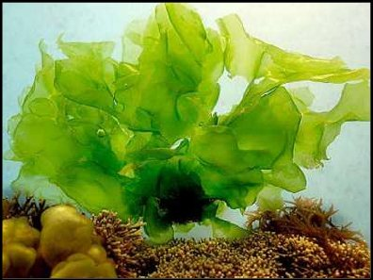
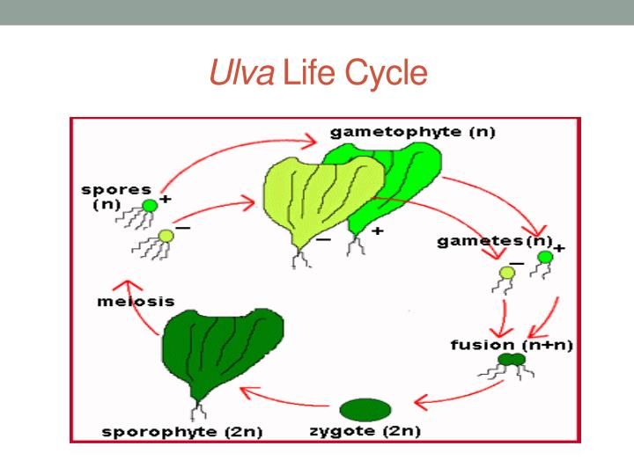
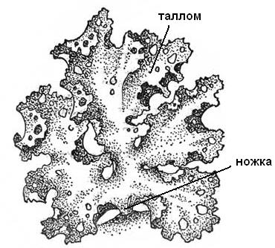
Ulva
Ulva lactuca, also known by the common name sea lettuce, is an edible green alga in the family
tallus
Ulva life cycle
holdfast

Slide 25
Material:
Division Chlorophyta - Green algae,
Class Conjugatophyceae,
Order Desmidiales,
Genus Closterium, Cosmarium
Objective: To investigate the structural features of Closterium, Cosmarium
Tasks of work:
Draw the appearance Closterium, Cosmarium, to note the shell at Closterium, chloroplasts, pyrenodes, vacuoles with gypsum crystals.

Slide 26
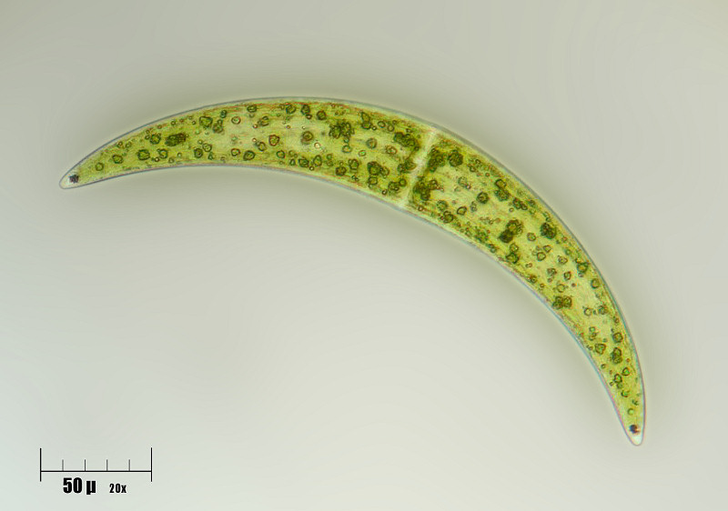
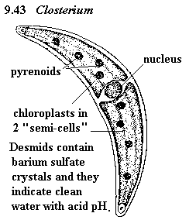
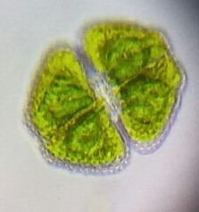
Most members of the family Desmidiaceae are characterized by a marked cell sinus dividing the cell into two distinctly separated semi cells.
Closterium is a genus of unicellular algae in the family Closteriaceae.
shell
Closterium
Cosmarium. In this complex genus the cells are very variable. All are constricted in the middle leading to its bi-lobed appearance
Cosmarium

Slide 27
Material:
Division Charophyta,
Class Charophyceae,
Order Charales,
Genus Chara
Objective: To investigate the structural features of Chara.
Tasks of work:
Draw the appearance Chara, oogony and anteridia. Label the “shoots” unlimited and limited growth, rhizoids, tuber.

Slide 28
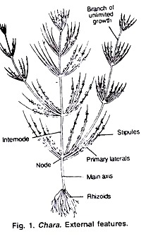
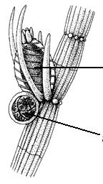
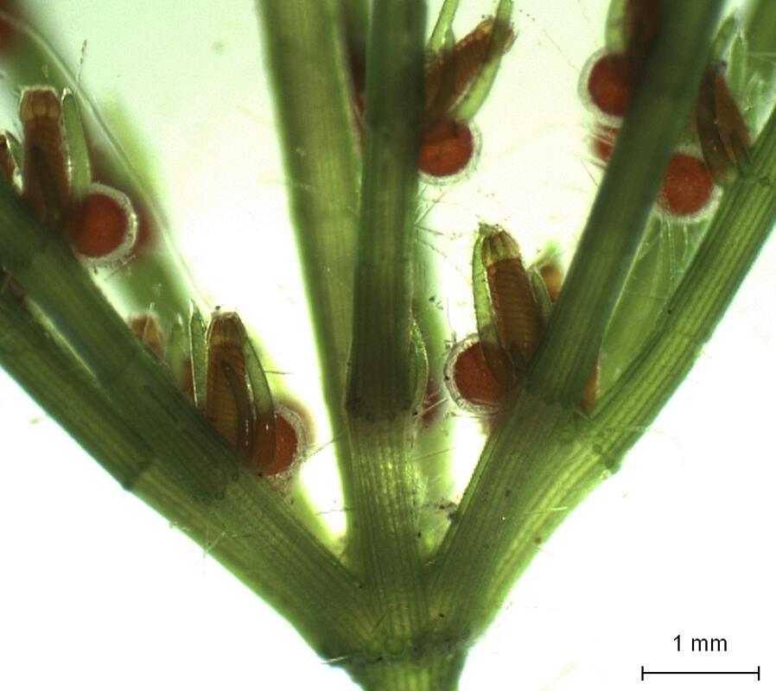
Chara
Chara is a genus of charophyte green algae in the family Characeae. They are multicellular and superficially resemble land plants because of stem-like and leaf-like structures. The thallus is mainly differentiated into rhizoids and main axis.
Reproduction in Chara takes place by vegetative and sexual methods. Asexual reproduction is absent.
The bulbils are spherical or oval tube-like structures which develop on rhizoids. The bulbils on detachment from plants germinate into new thallus.
oogonium
antheridium
Chara. External features

Slide 29
Division Bacillariophyta (DIATOMS)
General Characteristics of Bacillariophyta
The general characteristics of Bacillariophyta are as follows:
Unisellular or colonial with cell walls composed by silicates.
Single-celled, colony-shaped body shape by forming bilateral symmetry (pennales) and radial symmetries (centrales).
The arrangement of cells there is a cell wall called frustula composed of the base called hypoteka and the cap (epiteka) and belt (singulum). Frustulaini is composed of pectinyang coated silicon.
Epiteka and hypoteka are composed by the upper valve and the lower valve. Valve is composed of: rafe, stria, central nodulus and polar nodules. Pennales found mostly in fresh water. Centrales found mostly in seawater.
4. Movement of a flagell contained in sperm.
5. The contents of single-cell nuclei and diploid nucleus, pigment chlorophyll a and c, beta carotene and sertaxantofil (fukosantin).
6. Habitat is common in all water situations, but especially in cold water.
7. Reproduction occurs by cell division and auxospore formation. Note: Auxospora Formation. Stem cells will divide into 2 child cells, each child's cells will split into 2 daughter cells, the child's cells gradually decreases. The child's cell gradually grows to form auxospores.

Slide 30
Material:
Division Bacillariophyta (Diatoms)
Class Diatomophyceae
Order Bacillariales (cells have bilateral symmetry)
Fam. Diraphaceae (cells have two sutures - on the epiteka and hypotheka, they have active movement),
Genus Pinnularia
Objective: To investigate the structural features of Pinnularia
Tasks of work:
Draw the appearance of Pinnularia (valve view, girdle view).

Slide 31
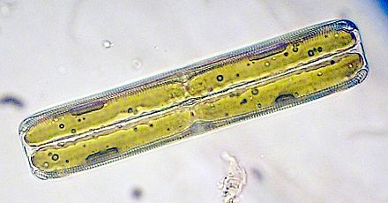
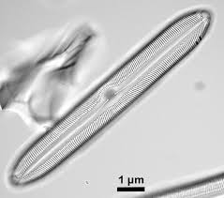
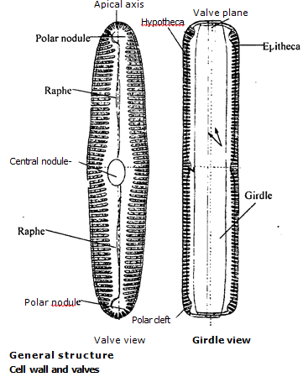

Slide 32
Material:
Division Euglenophyta
Class Euglenophyceae
Order Euglenales
Genus Euglena
Objective: To investigate the structural features of Euglena
Tasks of work:
Draw the appearance of Euglena.

Slide 33
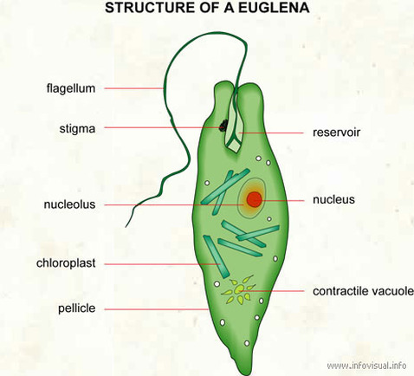
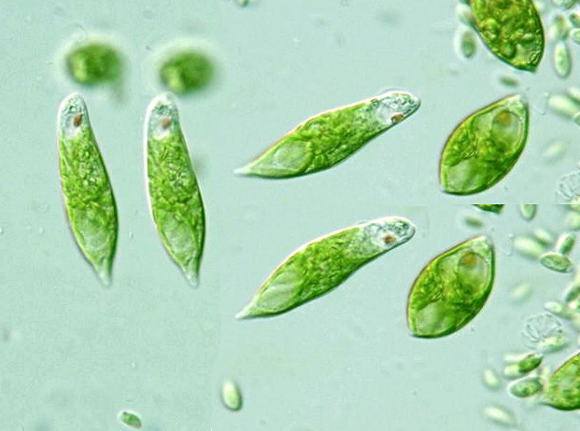

Slide 34
Phaeophyta (Brown Algae)
Phaeophyta Characteristics
1. Phaeophyta are the most complex forms of algae. The cell walls are composed of cellulose and alginic acid (a complex polysaccharide).
2. Unlike green algae or Chlorophyta, they lack true starch.
3. The food reserves contain sugar, higher alcohol and other complex forms of polysaccharides.
4. The members of phaeophyta belonging to Laminarales are called kelps.
5. Kelps are the only algae with a significant internal tissue differentiation.
6. Though true conductive tissues like xylem and phloem are absent, kelps show some sort of conductive tissues.
7. Similar to other evolved algal species, reproduction of this algae takes place by both sexual and asexual means.
8. Higher phaeophyta have life cycle consisting of both haploid and diploid stages, referred to as an alternation of generation. The thallus representing haploid stage and diploid stage may be similar (isomorphic) or different (heteromorphic).

Slide 35
Material:
Division Phaeophyta - Brown Algae
Class Fucophyceae
Order Laminariales,
Genus Laminaria
Order Fucales.
Genus Fucus.
Objective: To investigate the structural features of Laminaria, Fucus
Tasks of work:
Draw the appearance of Laminaria and its life cycle, Fucus, its spherical air bladders.

Slide 36
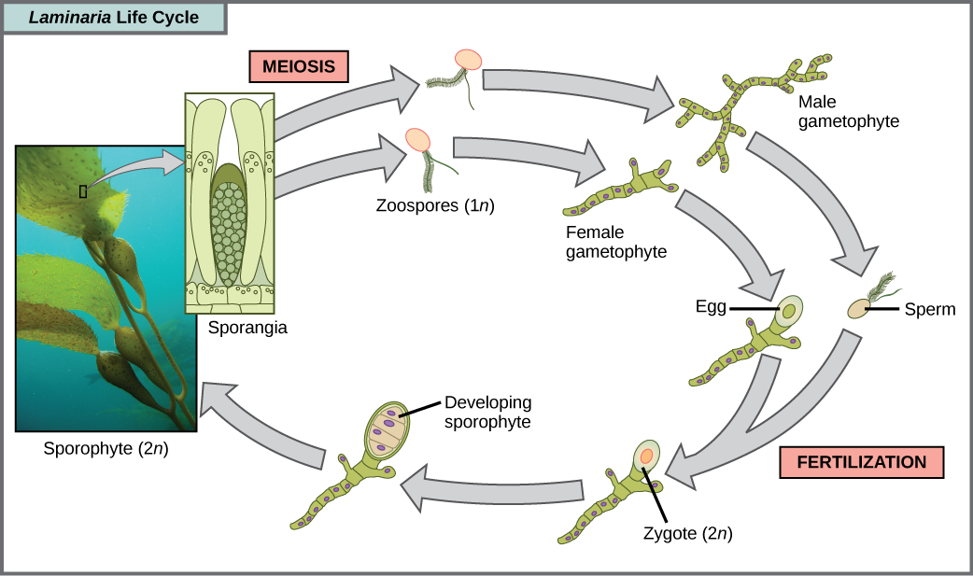
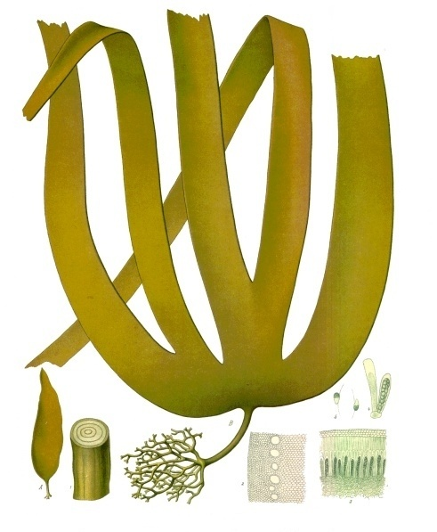
Laminaria
The sporophytic plant body is differentiated into holdfast, stipe and blade with high degree of morphological and anatomical differentiation. Sporangia are developed in distinct groups on both surfaces of the blade. The gametophytic plants are much reduced and dioecious. Plants of this group possess heteromorphic, diplohaplontic alternation of generations.

Slide 37
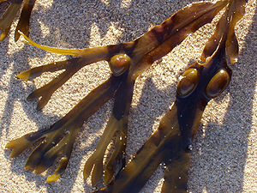
Thallus average. Development cycle without a change of generations, according to the diplophase type. The sexual process oogamy, reproduction of spores is absent.
air bladders
Fucus

